Slide 1

WEB Development
Grade 7&8

Slide 2
Recap of the last Class
Notes:
Objective:
Keep a healthy Discussion.
Product Section: Added and styled iPhone products using HTML and CSS.
Flexbox Grid: Organized product cards into a grid layout with equal spacing.
Button Styling: Styled the "Buy Now" buttons using CSS classes.
Responsive Design: Ensured the product grid remains responsive across devices.

Slide 3
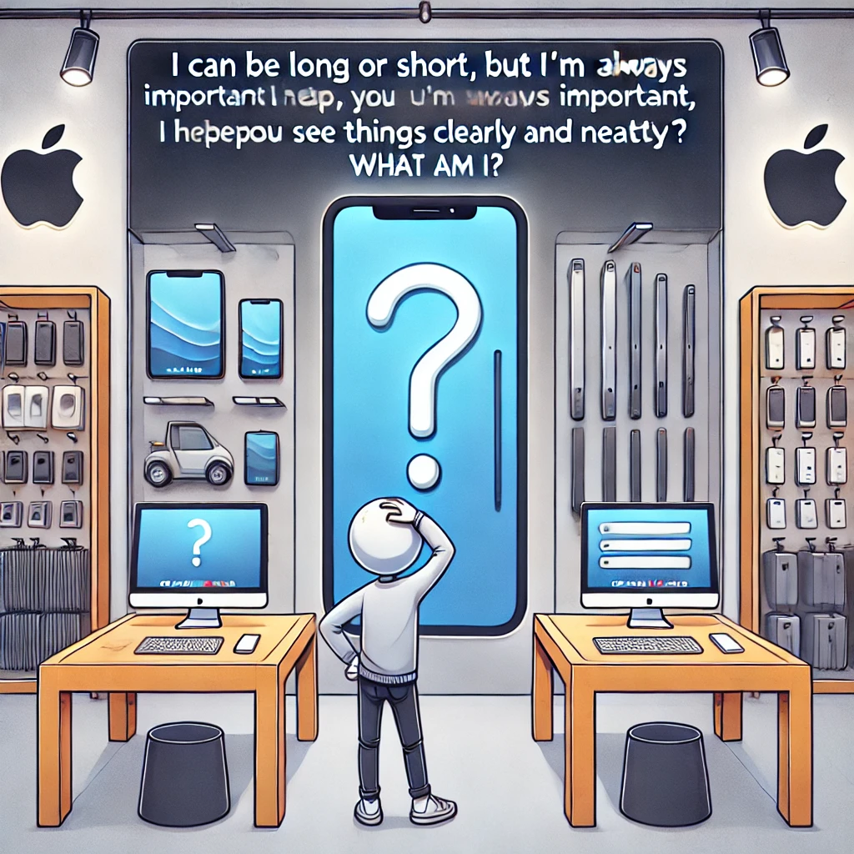
The Mystery of the Growing Knowledge
One day, while walking through the park, you stumble upon an old, mysterious sign. It reads:
"I am not alive, but I can grow. I don’t have eyes, but I can show. What am I?"
Can you solve this riddle and uncover the secret?
Notes:
Answer: A book!

Slide 4
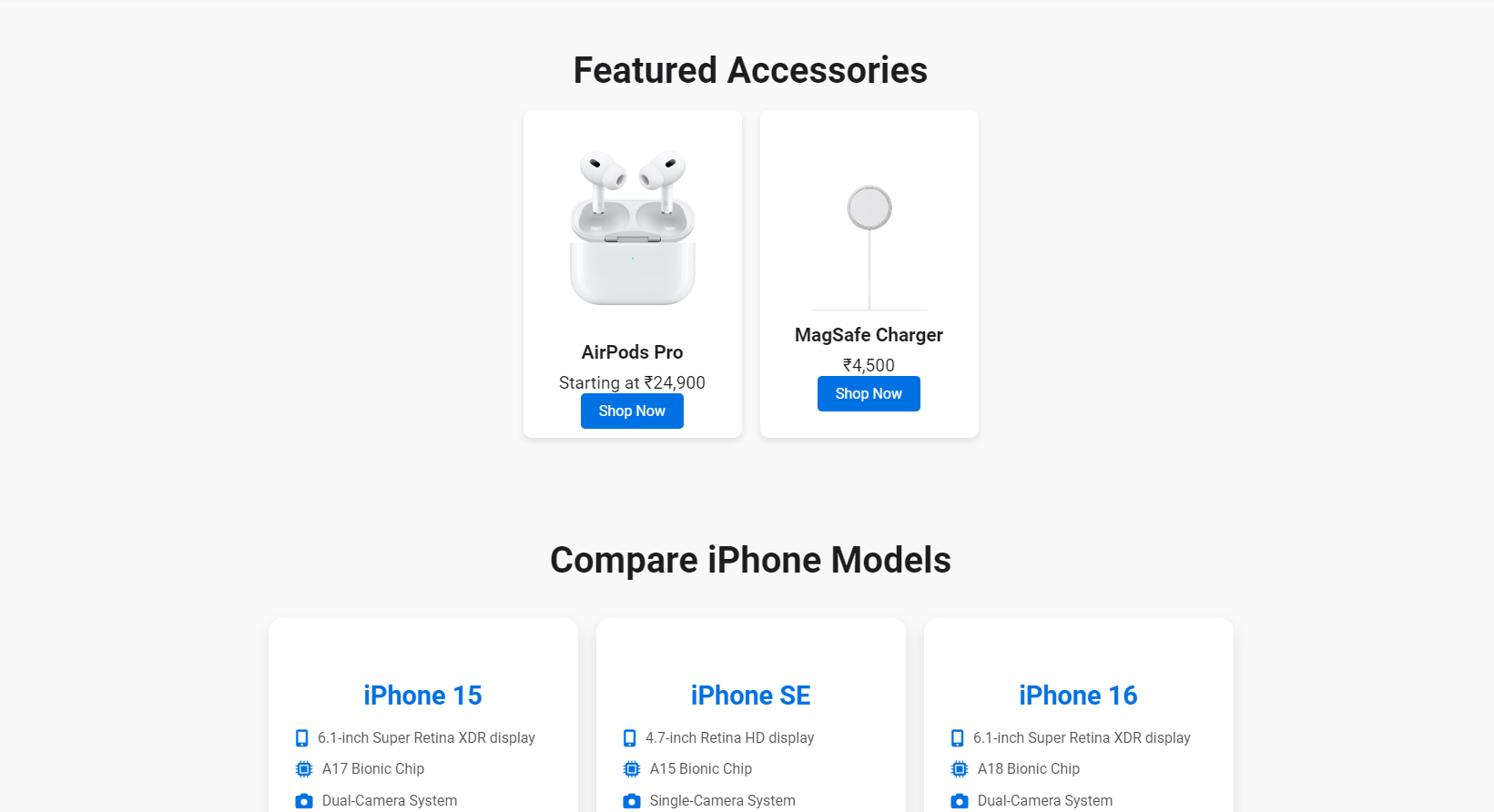
create a real-world online marketplace website
Notes:
Objective:
Create a engaging Product and Accessories Section
Day 3: Objective
Objective:
Creating the comparison section
Creating a beautiful footer section

Slide 5
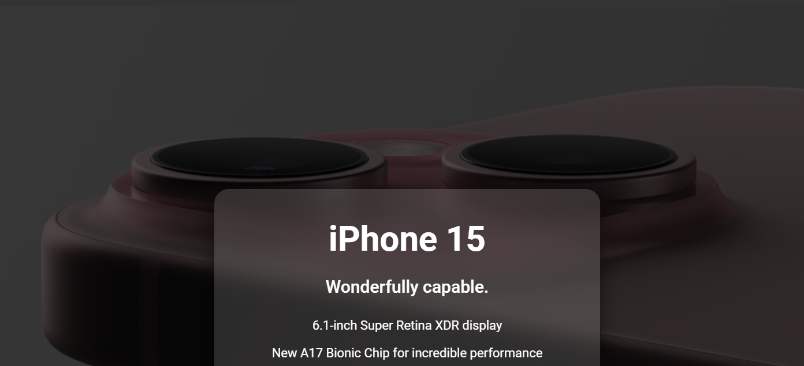
Project: Apple Clone
Notes:
Choose Level of Project Based on Student Capacity
Project Demo Link:
Basic Project Demo
Advance Project Demo
Project Code:
Basic: Apple Clone
Advance: Apple Clone
Objective:
Present the final project example.
Teacher Instructions:
Show the Screenshot:
Display the screenshot of the final project example.
Show the Project in Live Action:
Demonstrate the project on a live website to show how it functions.
Explain the Project:
Inform students that they will create a similar project.
Highlight the key features:
A responsive and user-friendly Webpage.
An engaging Hero Section.

Slide 6
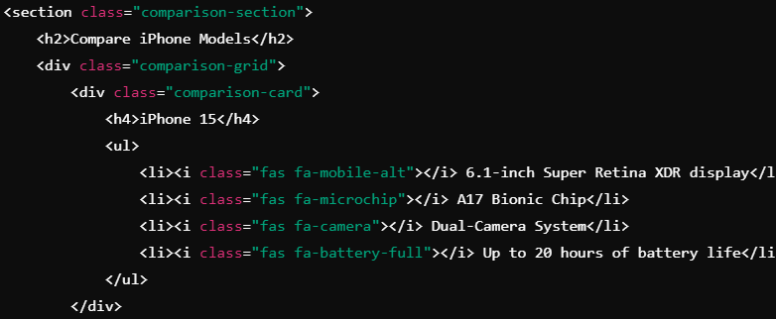
HTML Structure (Comparison Section)
Notes:
"Teacher's Activity"
Project Codebase:
Basic: Apple Clone
Advance: Apple Clone
Objective:
Understand how to create a basic html layout for a Comparision section
**** Use Tr code's for recap for better explanation and for code completion use code base. ****
Teacher Instructions:
Learn about how to use div, classes to separate code, Include Unordered List and icons
Provide an overview of the section:
Code Explanation:
This section compares different iPhone models with details about their display, processor, camera, and battery life.

Slide 7
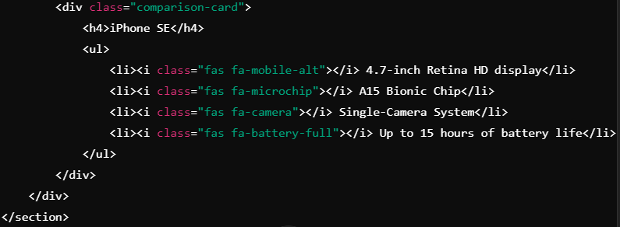
HTML Structure (Comparison Section)
Notes:
"Teacher's Activity"
Project Codebase:
Basic: Apple Clone
Advance: Apple Clone
Objective:
Understand how to create a basic html layout for a Comparision section
**** Use Tr code's for recap for better explanation and for code completion use code base. ****
Teacher Instructions:
Learn about how to use div, classes to separate code, Include Unordered List and icons
Provide an overview of the section:
Code Explanation:
This section compares different iPhone models with details about their display, processor, camera, and battery life.

Slide 8
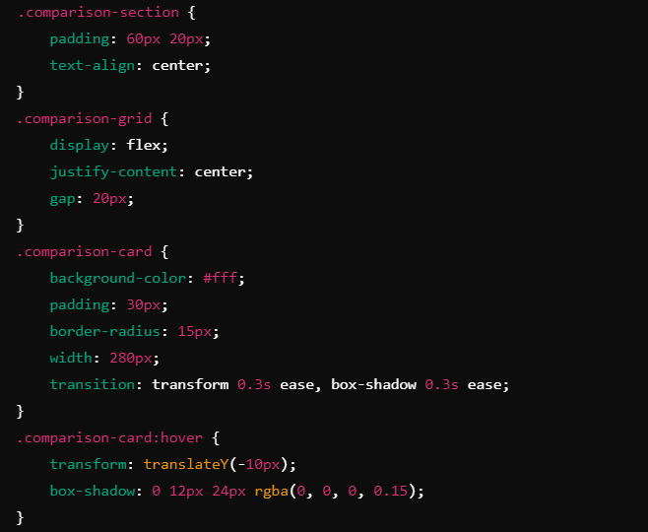
CSS (Comparison Section)
Notes:
"Teacher's Activity"
Project Codebase:
Basic: Apple Clone
Advance: Apple Clone
Objective:
Understand how to style the Comparision Section understand about flex box and Content alignment
**** Use Tr code's for recap for better explanation and for code completion use code base. ****
Teacher Instructions:
Display the screenshot of the CSS code.
Provide an overview of the section:
Code Explanation:
The .comparison-grid arranges comparison cards side by side. The .comparison-card:hover adds a subtle animation when the user hovers over a card.

Slide 9
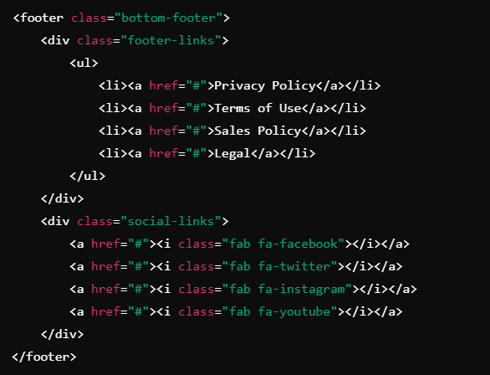
Footer Structure
Notes:
"Teacher's Activity"
Project Codebase:
Basic: Apple Clone
Advance: Apple Clone
Objective:
Understand how to create a Footer section layout using HTML
**** Use Tr code's for recap for better explanation and for code completion use code base. ****
Teacher Instructions:
Display the screenshot of the HTML code.
Provide an overview of the section:
Code Explanation:
The footer provides links to privacy policies, terms, and social media icons.

Slide 10
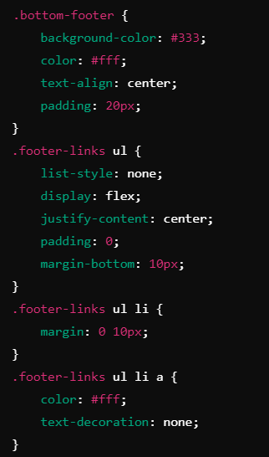
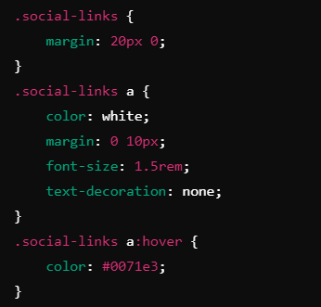
CSS (Footer)
Notes:
"Teacher's Activity"
Project Codebase:
Basic: Apple Clone
Advance: Apple Clone
Objective:
Understand how to style the footer section
**** Use Tr code's for recap for better explanation and for code completion use code base. ****
Teacher Instructions:
Display the screenshot of the CSS code.
Provide an overview of the section:
Code Explanation:
The .bottom-footer class adds a dark background and white text for contrast.
The .footer-links ul centers the links horizontally using flexbox.
.social-links a:hover changes the color of social icons when hovered over.

Slide 11
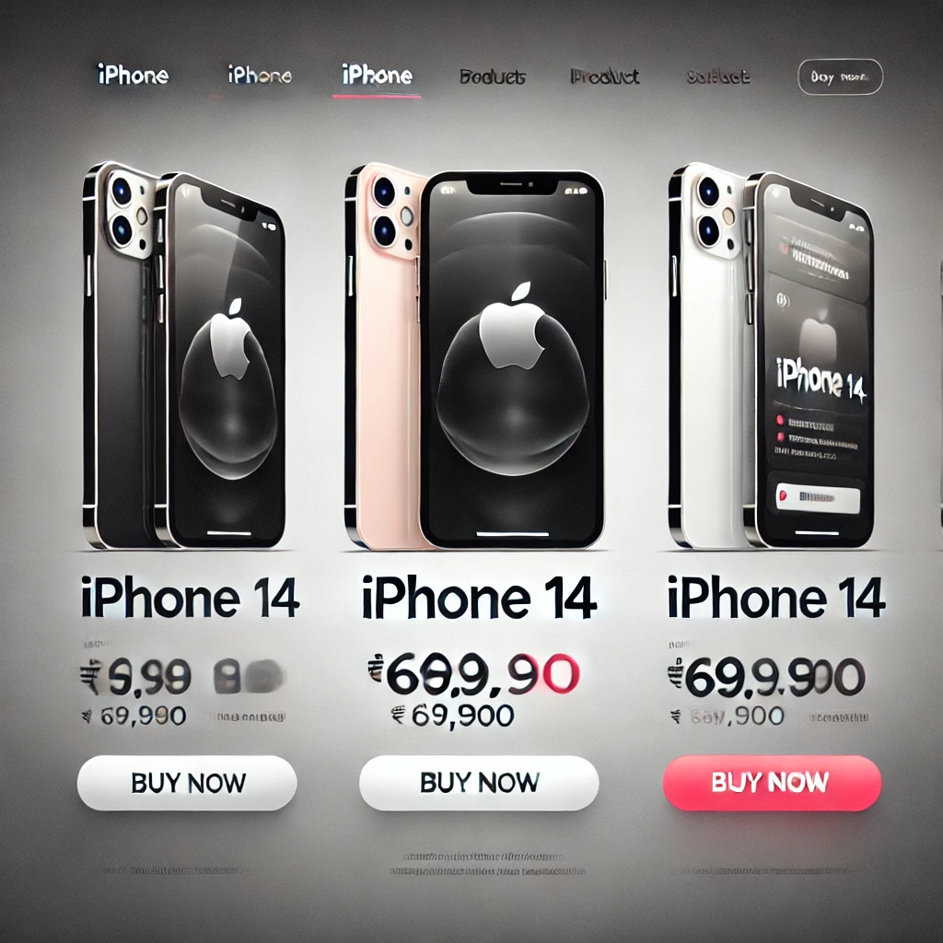
Now it's your turn!
add a new iPhone 13 to the comparison section with the following details:
Display: 6.1-inch Super Retina XDR display
Chip: A15 Bionic Chip
Camera: Dual-Camera System
Battery: Up to 19 hours of battery life
Storage: 128GB, 256GB, 512GB
Colors: Blue, Green, Red
Ensure that the new iPhone 13 card matches the style of the existing comparison cards.
Notes:
"Students' Activity"
Objective:
The task will help students practice adding new content to the product grid, reinforcing HTML structure and basic CSS styling.
Instructions:
Instruct students to update the details.
They should ensure the new product follows the same style.
Review:
After the 5 minutes, have students save and refresh their browsers to ensure the new iPhone 13 is correctly added and aligned with the other products.

Slide 12

Question:
What HTML tag is used to group the features of each iPhone in the comparison section?
A) <li>
B) <ul>
C) <div>
D) <h4>
Notes:
Answer: B) <ul>

Slide 13
Question:
Which CSS property is used to create hover effects on the comparison cards?
A) box-shadow
B) border
C) transition
D) opacity
Notes:
Answer: C) transition

Slide 14
Question:
What CSS property ensures that the comparison cards have rounded corners?
A) border-width
B) border-radius
C) padding
D) margin
Notes:
Answer: B) border-radius

Slide 15
Question:
Which HTML element is used to add the social media icons in the footer?
A) <img>
B) <i>
C) <span>
D) <a>
Notes:
Answer: B) <i>

Slide 16
Question:
In the footer, what CSS property is used to center the social media links horizontally?
A) align-items
B) justify-content
C) text-align
D) margin
Notes:
Answer: B) justify-content

Slide 17
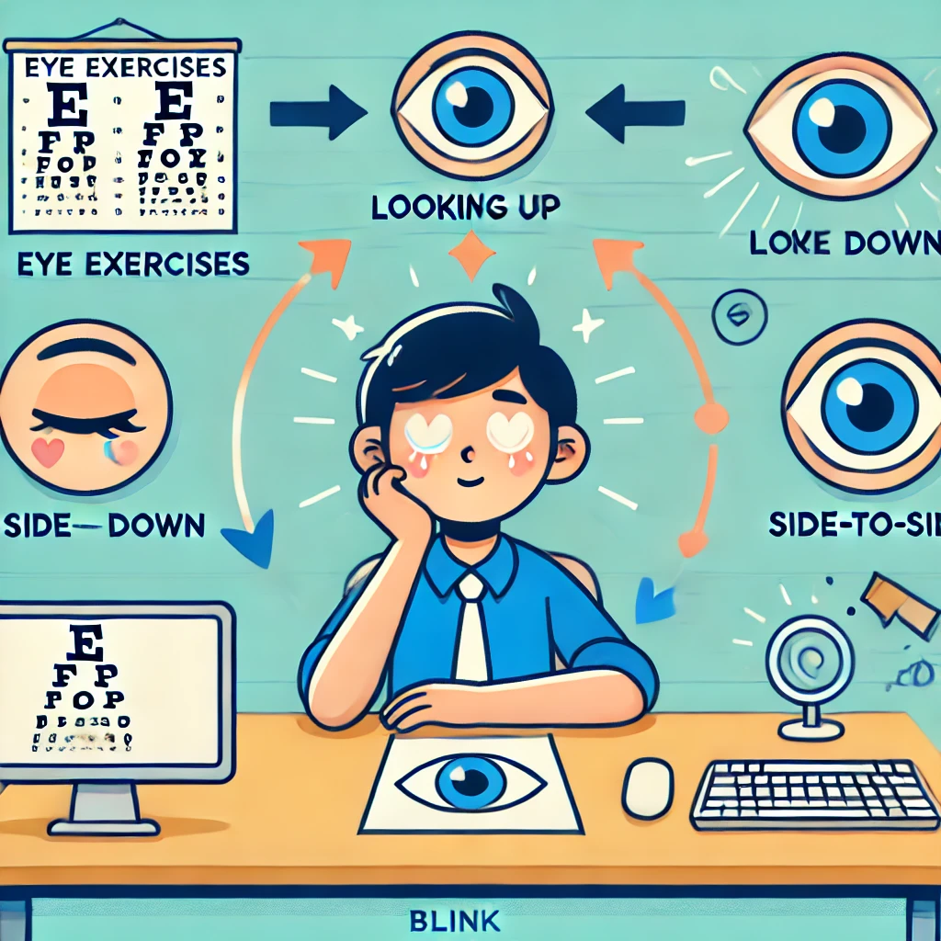
Eye Exercises
Notes:
Teacher Instruction : Explain importance of eye exercises
Why Eye Exercises Matter:
Staring at screens for long periods can strain your eyes.
Taking regular breaks keeps your eyes healthy and relaxed.
Simple Eye Exercises:
Look up and down: Slowly move your eyes up and down 5 times.
Side-to-side: Move your eyes from left to right 5 times.
Blinking: Blink quickly for 10 seconds to refresh your eyes.
Focus shift: Look at something far away for 20 seconds, then something close for 20 seconds.

Slide 18

Comparison Section: Built a comparison grid for different iPhone models using HTML and CSS.
Hover Effects: Added interactive hover effects to the comparison cards.
Footer Design: Created a footer with links to legal pages and social media icons.
CSS Styling: Used properties like border-radius and box-shadow to enhance card design.
What have we learnt?
Notes:
Objective:
Summarize the key learnings from the lesson.
Teacher Instructions:
Instruct Student's to recap Today's Learning
Keep a healthy discussion engage student to a group discussion
Show a glimpse of what is awaiting to be reveal on the next class

Slide 19

Homework Discussion
Notes:
Instructions for the Teacher: Facilitate a discussion about the homework assignment.

Slide 20

Be careful when sharing personal information online.
Never share your passwords, home address, phone number, or personal details on websites, social media, or with strangers. Always ask a trusted adult if you're unsure about what information is safe to share.

